Slide 1

Database Systems -
Introduction to Databases and Data Warehouses

Slide 2
INTRODUCTION
Entity-relationship (ER) modeling - conceptual database modeling technique
  Enables the structuring and organizing of the requirements collection process
  Provides a way to graphically represent the requirements
ER diagram (ERD) - the result of ER modeling
  Serves as a blueprint for the database
Jukić, Vrbsky, Nestorov – Database Systems
Chapter 2 – Slide <number>

Slide 3
ENTITIES
Entities - constructs that represent what the database keeps track of
  The basic building blocks of an ER diagram
  Represent various real world notions, such as people, places, objects, events, items, and other concepts
  Within one ERD each entity must have a different name
Jukić, Vrbsky, Nestorov – Database Systems
Chapter 2 – Slide <number>
Notes:
An ER diagram for a retail company may contain entities, such as CUSTOMER, STORE, PRODUCT and SALES TRANSACTION.

Slide 4
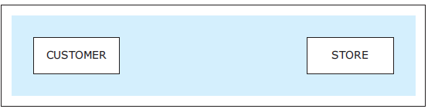
ENTITIES
Two entities
Jukić, Vrbsky, Nestorov – Database Systems
Chapter 2 – Slide <number>

Slide 5
ENTITIES
Entity instances (entity members) - occurrences of an entity
  Entities themselves are depicted in the ER diagrams while entity instances are not
  Entity instances are eventually recorded in the database that is created based on the ER diagram
Jukić, Vrbsky, Nestorov – Database Systems
Chapter 2 – Slide <number>
Notes:
Each depicted entity contains a number of entity instances or entity members. For example entity CUSTOMER may contain entity instances such as customer Joe, customer Sue, and customer Pat.

Slide 6
ATTRIBUTES
Attribute - depiction of a characteristic of an entity
  Represents the details that will be recorded for each entity instance
  Within one entity, each attribute must have a different name
Unique Attribute - attribute whose value is different for each entity instance
  Every regular entity must have at least one unique attribute
Jukić, Vrbsky, Nestorov – Database Systems
Chapter 2 – Slide <number>

Slide 7
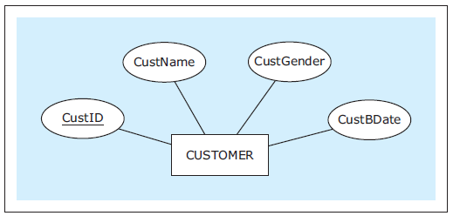
ATTRIBUTES
An entity with attributes
Jukić, Vrbsky, Nestorov – Database Systems
Chapter 2 – Slide <number>
Notes:
This example is discussed on Page 14.

Slide 8
RELATIONSHIPS
Relationship - ER modeling construct depicting how entities are related
  Within an ER diagram, each entity must be related to at least one other entity via a relationship
Jukić, Vrbsky, Nestorov – Database Systems
Chapter 2 – Slide <number>

Slide 9
RELATIONSHIPS
Cardinality constraints - depict how many instances of one entity can be associated with instances of another entity
  Maximum cardinality
    One (represented by a straight bar: I)
    Many (represented by a crow’s foot symbol)
  Minimum cardinality (participation)
    Optional (represented by a circular symbol: 0)
    Mandatory (represented by a straight bar: I)
Jukić, Vrbsky, Nestorov – Database Systems
Chapter 2 – Slide <number>

Slide 10
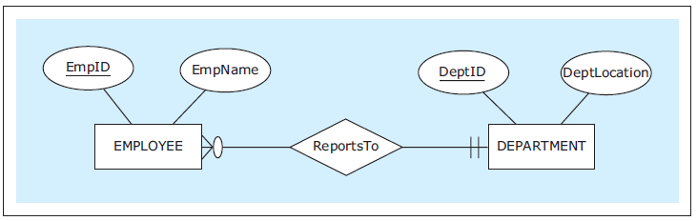
RELATIONSHIPS
A relationship between two entities
Jukić, Vrbsky, Nestorov – Database Systems
Chapter 2 – Slide <number>
Notes:
The requirements for the relationship ReportsTo and the rules for interpreting cardinality constraints are given on Pages 14-15.

Slide 11
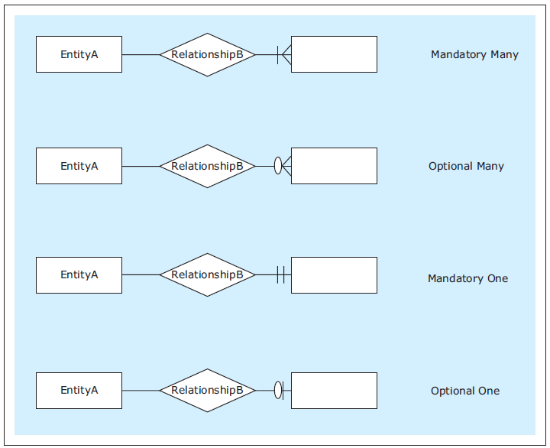
RELATIONSHIPS
Four possible cardinality constraints
Jukić, Vrbsky, Nestorov – Database Systems
Chapter 2 – Slide <number>

Slide 12
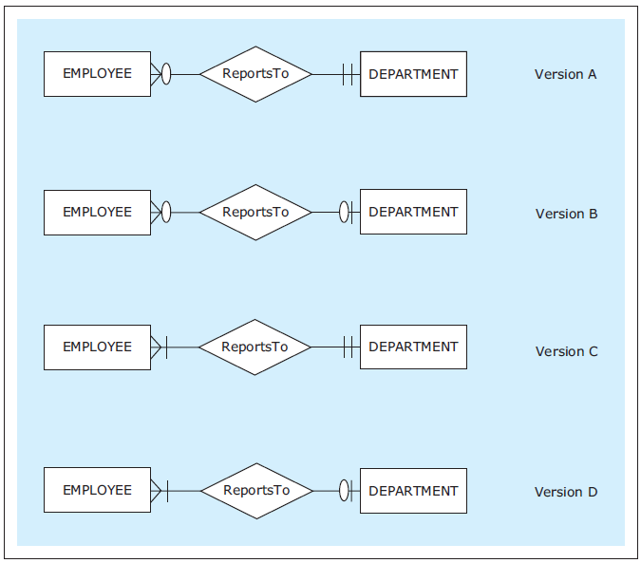
RELATIONSHIPS
Several possible versions of the relationship ReportsTo
Jukić, Vrbsky, Nestorov – Database Systems
Chapter 2 – Slide <number>
Notes:
The requirements for each of the versions shown are given on Pages 16-17.

Slide 13
RELATIONSHIPS
Types of Relationships (maximum cardinality-wise)
  One-to-one relationship (1:1)
  One-to-many relationship (1:M)
  Many-to-many relationship (M:N)
Jukić, Vrbsky, Nestorov – Database Systems
Chapter 2 – Slide <number>
Notes:
The maximum cardinality on either side of the relationship can be either one or many.

Slide 14
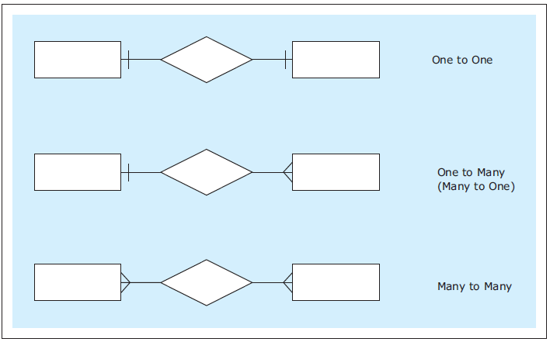
RELATIONSHIPS
Three types of relationships (maximum cardinality-wise)
Jukić, Vrbsky, Nestorov – Database Systems
Chapter 2 – Slide <number>

Slide 15
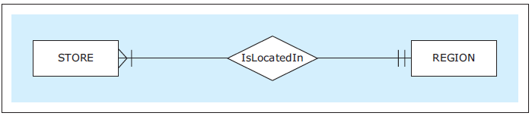
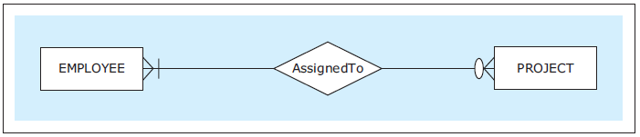
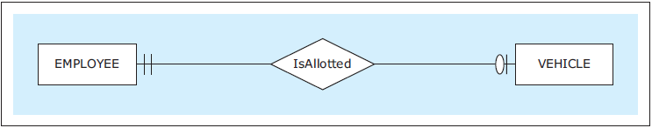
RELATIONSHIPS
A 1:M Relationship
A M:N Relationship
A 1:1 Relationship
Jukić, Vrbsky, Nestorov – Database Systems
Chapter 2 – Slide <number>
Notes:
The requirements for the three relationships (IsLocatedIn, AssignedTo, IsAlloted) are given on Page 18.

Slide 16
RELATIONSHIPS
Relationship instances - occurrences of a relationship
  Occur when an instance of one entity is related to an instance of another entity via a relationship
  Relationship themselves are depicted in the ER diagrams while relationship instances are not
  Relationship instances are eventually recorded in the database that is created based on the ER diagram
Jukić, Vrbsky, Nestorov – Database Systems
Chapter 2 – Slide <number>

Slide 17
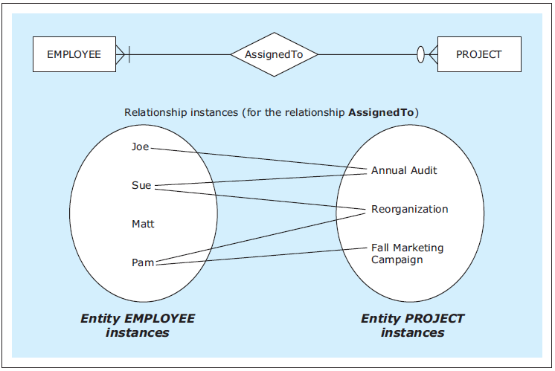
RELATIONSHIPS
A relationship and its instances
Jukić, Vrbsky, Nestorov – Database Systems
Chapter 2 – Slide <number>
Notes:
Illustrated relationship instances reflect the cardinality constraint symbols of the relationship.

Slide 18
RELATIONSHIPS
Relationship attributes
  In some cases M:N relationships can actually have attributes of their own
Jukić, Vrbsky, Nestorov – Database Systems
Chapter 2 – Slide <number>
Notes:
An attribute of a 1:M relationship or a 1:1 relationship is not necessary.

Slide 19
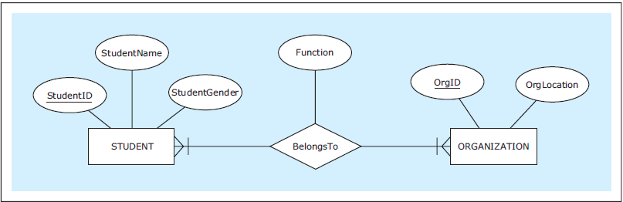
RELATIONSHIPS
A M:N relationship with an attribute
Jukić, Vrbsky, Nestorov – Database Systems
Chapter 2 – Slide <number>
Notes:
The requirements for the ER diagram shown are given on Page 19.

Slide 20
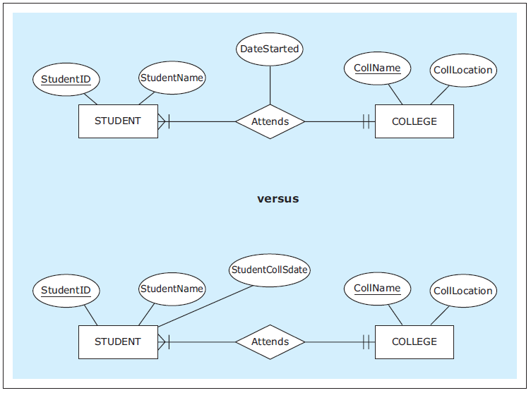
RELATIONSHIPS
A 1:M relationship with and without an attribute
Jukić, Vrbsky, Nestorov – Database Systems
Chapter 2 – Slide <number>
Notes:
The requirements and the discussion of the two ER diagrams shown here are given on Page 20.

Slide 21
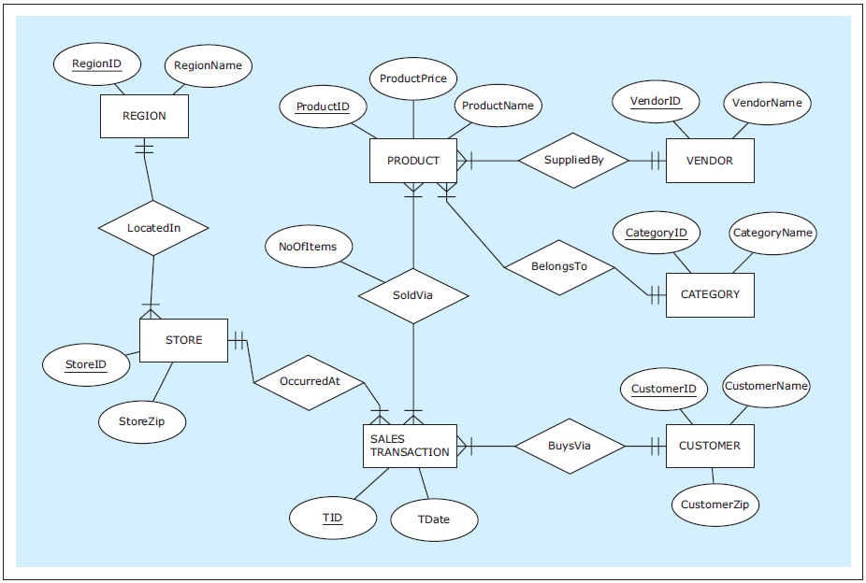
ER diagram example: ZAGI Retail Company Sales Department Database
Jukić, Vrbsky, Nestorov – Database Systems
Chapter 2 – Slide <number>
Notes:
ZAGI Retail Company Sales Department Database requirements are given on Page 21.
The knowledge of ER notation helps database requirements collectors gather structured and useful requirements for the future database.
Knowing that an ER diagram has to be developed upon the completion of the database requirements process helps database requirements collectors focus on asking the right questions. Examples of such questions are given on Page 22.

Slide 22
ATTRIBUTES
Composite attribute – attribute that is composed of several attributes
  Not an additional attribute of an entity
  Its purpose is to indicate a situation in which a collection of attributes has an additional meaning, besides the individual meanings of each attribute
Jukić, Vrbsky, Nestorov – Database Systems
Chapter 2 – Slide <number>

Slide 23
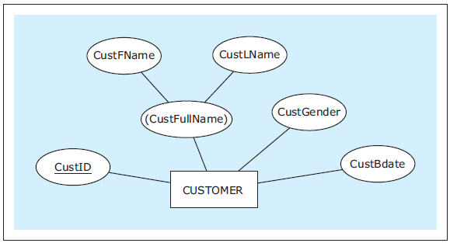
ATTRIBUTES
An entity with a composite attribute
Jukić, Vrbsky, Nestorov – Database Systems
Chapter 2 – Slide <number>
Notes:
This example is discussed on Page 22.

Slide 24
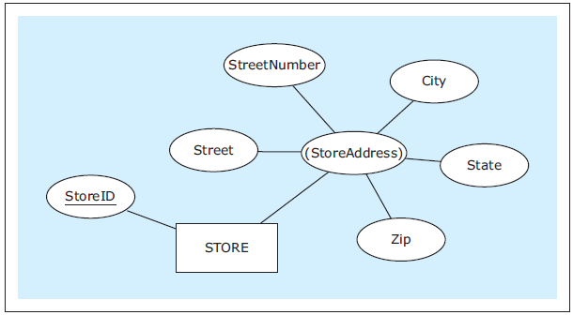
ATTRIBUTES
Another entity with a composite attribute
Jukić, Vrbsky, Nestorov – Database Systems
Chapter 2 – Slide <number>
Notes:
This example is discussed on Page 22.

Slide 25
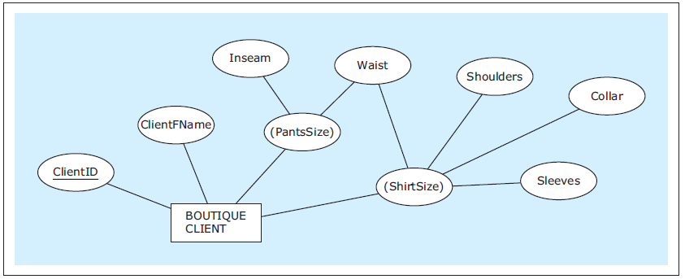
ATTRIBUTES
Composite attributes sharing components
Jukić, Vrbsky, Nestorov – Database Systems
Chapter 2 – Slide <number>
Notes:
This example is discussed on Pages 22-23.

Slide 26
ATTRIBUTES
Composite unique attribute – attribute that is composed of several attributes and whose value is different for each entity instance
Jukić, Vrbsky, Nestorov – Database Systems
Chapter 2 – Slide <number>

Slide 27
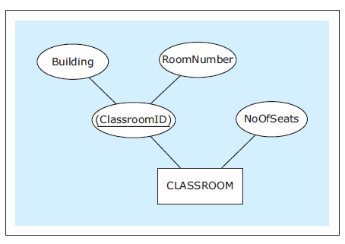
ATTRIBUTES
An entity with a unique composite attribute
Jukić, Vrbsky, Nestorov – Database Systems
Chapter 2 – Slide <number>
Notes:
This example is discussed on Pages 23-24.

Slide 28
ATTRIBUTES
Multiple unique attributes (candidate keys) - when an entity has more than one unique attribute each unique attribute is also called a candidate key
Jukić, Vrbsky, Nestorov – Database Systems
Chapter 2 – Slide <number>
Notes:
The term “candidate key” comes from the fact that a candidate key is a “candidate” to be chosen as the primary identifier (also known as a primary key) when implementing the resulting database. One of the candidate keys is chosen later as the “primary key” for the table corresponding to the entity that contains the candidate keys. Primary keys are discussed in Chapter 3.

Slide 29
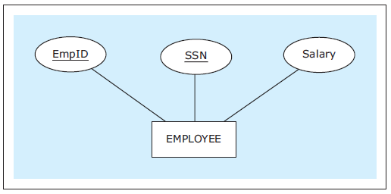
ATTRIBUTES
An entity with multiple unique attributes (candidate keys)
Jukić, Vrbsky, Nestorov – Database Systems
Chapter 2 – Slide <number>
Notes:
This example is discussed on Page 24.

Slide 30
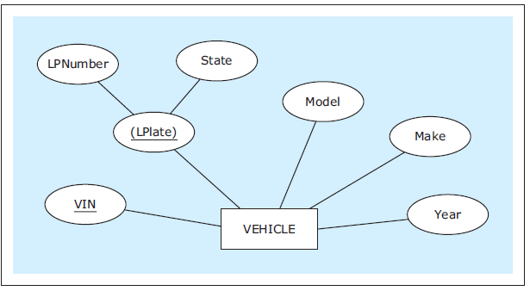
ATTRIBUTES
An entity with a regular and composite candidate key
Jukić, Vrbsky, Nestorov – Database Systems
Chapter 2 – Slide <number>
Notes:
This example is discussed on Page 24.

Slide 31
ATTRIBUTES
Multivalued attribute - attribute for which instances of an entity can have multiple values for the same attribute
Jukić, Vrbsky, Nestorov – Database Systems
Chapter 2 – Slide <number>
Notes:
Used in cases in which there is a variable number of values that can be assigned to the particular attribute of the entity.

Slide 32
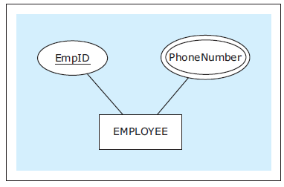
ATTRIBUTES
A multivalued attribute
Jukić, Vrbsky, Nestorov – Database Systems
Chapter 2 – Slide <number>
Notes:
This example is discussed on Page 25.

Slide 33
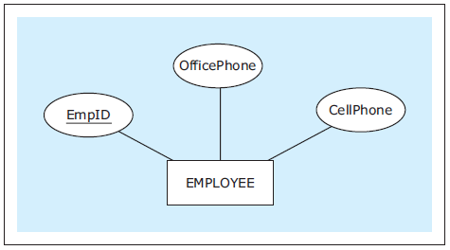
ATTRIBUTES
A scenario that does not use multivalued attributes
Jukić, Vrbsky, Nestorov – Database Systems
Chapter 2 – Slide <number>
Notes:
This example is discussed on Page 25.

Slide 34
ATTRIBUTES
Derived attribute - attribute whose values are calculated and not permanently stored in a database
Jukić, Vrbsky, Nestorov – Database Systems
Chapter 2 – Slide <number>
Notes:
The value of a derived attribute is calculated from the stored values of other attributes and/or additional available data (such as current date).

Slide 35
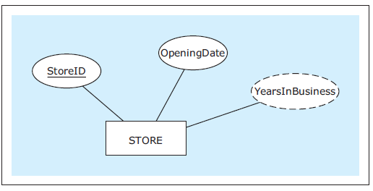
ATTRIBUTES
A derived attribute example
Jukić, Vrbsky, Nestorov – Database Systems
Chapter 2 – Slide <number>
Notes:
This example is discussed on Page 25.

Slide 36
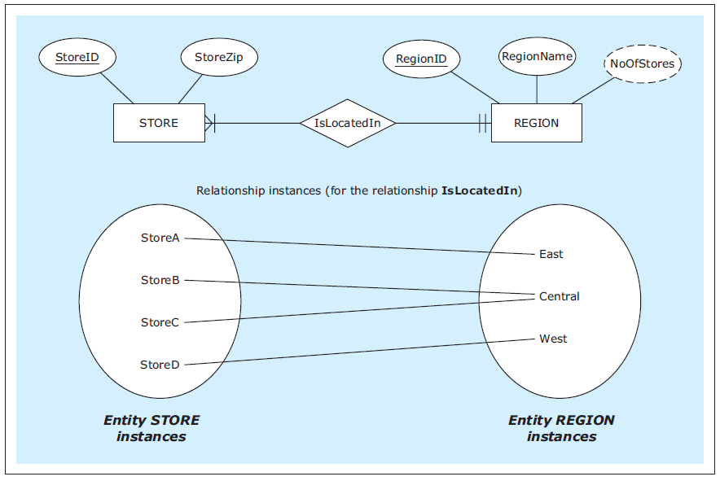
ATTRIBUTES
Another derived attribute example
Jukić, Vrbsky, Nestorov – Database Systems
Chapter 2 – Slide <number>
Notes:
This example is discussed on Page 25.

Slide 37
ATTRIBUTES
Optional attribute - attribute that is allowed to not have a value
Jukić, Vrbsky, Nestorov – Database Systems
Chapter 2 – Slide <number>
Notes:
Typically, most attributes are required attributes (attributes that must have a value for each entity instance). However, some attributes are optional attributes.

Slide 38
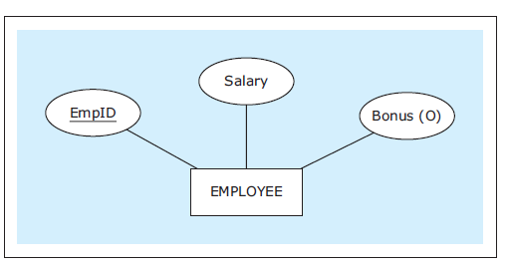
ATTRIBUTES
An optional attribute example
Jukić, Vrbsky, Nestorov – Database Systems
Chapter 2 – Slide <number>
Notes:
This example is discussed on Page 26.

Slide 39
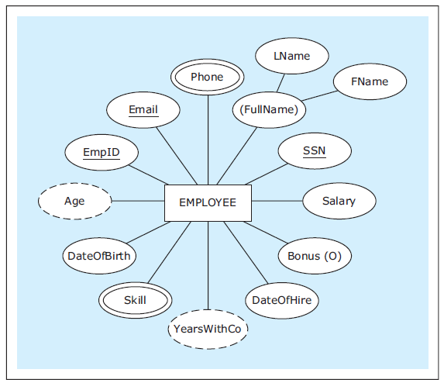
ATTRIBUTES
EXAMPLE: An entity with various types of attributes
Jukić, Vrbsky, Nestorov – Database Systems
Chapter 2 – Slide <number>
Notes:
This example is discussed on Page 27.

Slide 40
RELATIONSHIPS
Exact minimum and maximum cardinality in relationships
  In some cases the exact minimum and/or maximum cardinality in relationships is known in advance
  Exact minimum/and or maximum cardinalities can be depicted in ER diagrams
Jukić, Vrbsky, Nestorov – Database Systems
Chapter 2 – Slide <number>

Slide 41
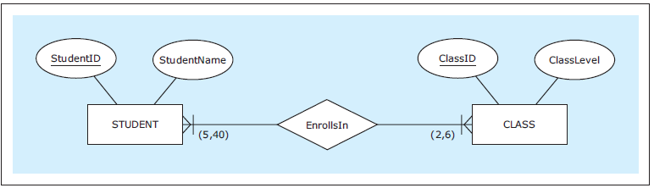
RELATIONSHIPS
A relationship with specific minimum and maximum cardinalities
Jukić, Vrbsky, Nestorov – Database Systems
Chapter 2 – Slide <number>
Notes:
This example is discussed on Page 27.

Slide 42
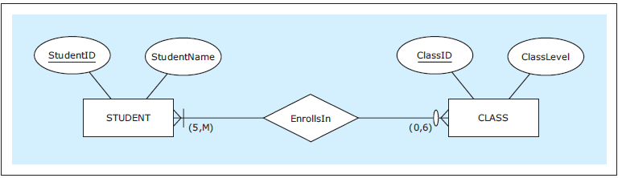
RELATIONSHIPS
A relationship with a mixture of specific and non-specific cardinalities
Jukić, Vrbsky, Nestorov – Database Systems
Chapter 2 – Slide <number>
Notes:
This example is discussed on Page 28.

Slide 43
RELATIONSHIPS
Degree of a relationship - reflects how many entities are involved in the relationship
Binary relationship - relationship between two entities
(degree 2 relationship)
Unary relationship (recursive relationship) - occurs when an entity is involved in a relationship with itself
(degree 1 relationship)
Jukić, Vrbsky, Nestorov – Database Systems
Chapter 2 – Slide <number>
Notes:
A majority of relationships in business-related ER diagrams are binary relationships.

Slide 44
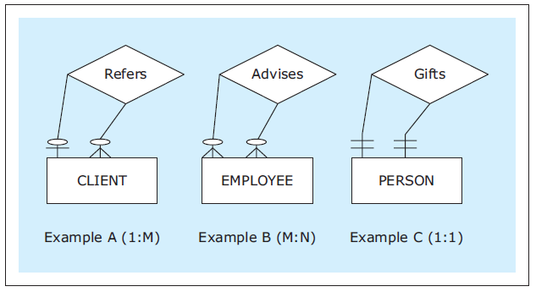
RELATIONSHIPS
Unary relationship examples
Jukić, Vrbsky, Nestorov – Database Systems
Chapter 2 – Slide <number>
Notes:
This example is discussed on Page 28.

Slide 45
RELATIONSHIPS
Relationship roles - additional syntax that can be used in ER diagrams at the discretion of a data modeler to clarify the role of each entity in a relationship
Jukić, Vrbsky, Nestorov – Database Systems
Chapter 2 – Slide <number>
Notes:
Relationship roles can be used in relationships of any degree, but their usefulness is most apparent when they are used in unary relationships.

Slide 46
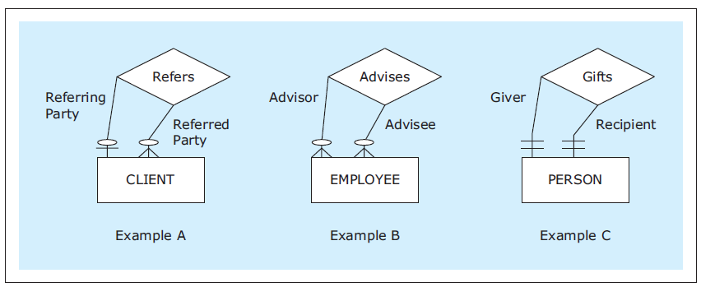
RELATIONSHIPS
Unary relationships with role names
Jukić, Vrbsky, Nestorov – Database Systems
Chapter 2 – Slide <number>
Notes:
This example is discussed on Page 29.

Slide 47
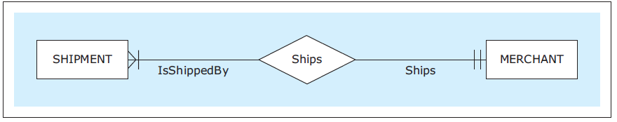
RELATIONSHIPS
A binary relationship with role names
Jukić, Vrbsky, Nestorov – Database Systems
Chapter 2 – Slide <number>
Notes:
The same ER diagram without the relationship roles would be just as informative, while containing less verbiage.

Slide 48
RELATIONSHIPS
Multiple relationships between same entities
  Same entities in an ER diagram can be related via more than one relationship
Jukić, Vrbsky, Nestorov – Database Systems
Chapter 2 – Slide <number>

Slide 49
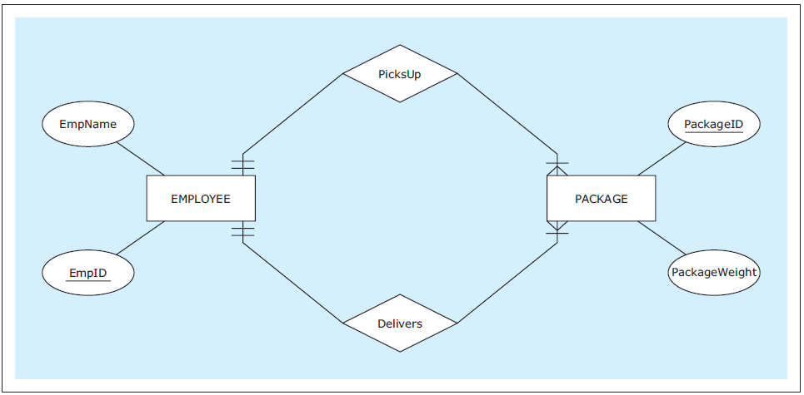
RELATIONSHIPS
Multiple relationships between the same entities
Jukić, Vrbsky, Nestorov – Database Systems
Chapter 2 – Slide <number>
Notes:
This example is discussed on Page 30.

Slide 50
WEAK ENTITY
Weak entity - ER diagram construct depicting an entity that does not have a unique attribute of its own
Owner entity - entity whose unique attribute provides a mechanism for identifying instances of a weak entity
Identifying relationship - relationship between a weak entity and its owner entity in which each instance of a weak entity is associated with exactly one instance of an owner entity
  Each weak entity must be associated with its owner entity via an identifying relationship
  Unique attribute from the owner entity uniquely identifies every instance of the weak entity via an identifying relationship
Jukić, Vrbsky, Nestorov – Database Systems
Chapter 2 – Slide <number>

Slide 51
WEAK ENTITY
Partial key - attribute of a weak entity that combined with the unique attribute of the owner entity uniquely identifies the weak entity's instances
  Combination of the partial key and the unique attribute from the owner entity uniquely identifies every instance of the weak entity
Jukić, Vrbsky, Nestorov – Database Systems
Chapter 2 – Slide <number>

Slide 52
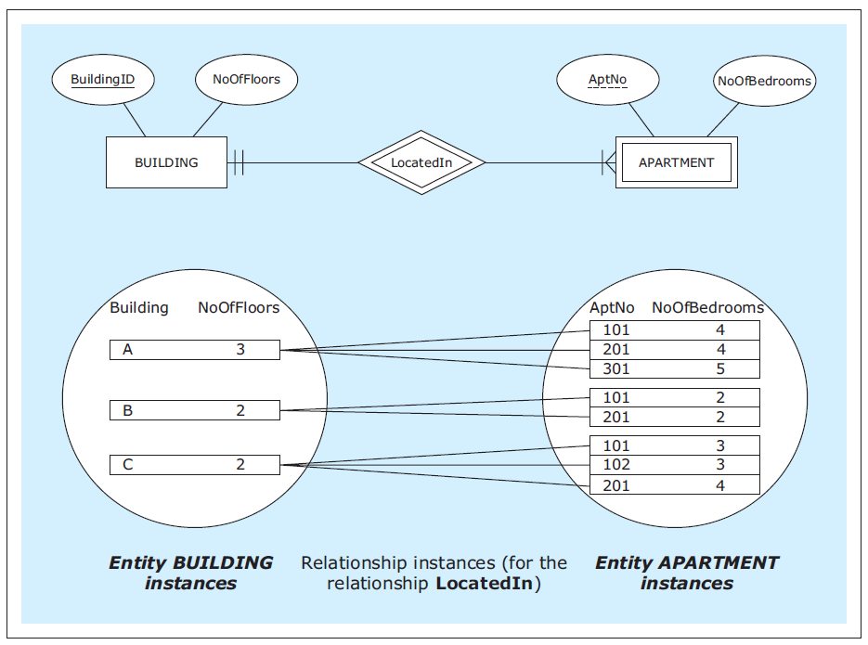
WEAK ENTITY
A weak entity example with entity instances
Jukić, Vrbsky, Nestorov – Database Systems
Chapter 2 – Slide <number>
Notes:
This example is discussed on Pages 30-31.

Slide 53
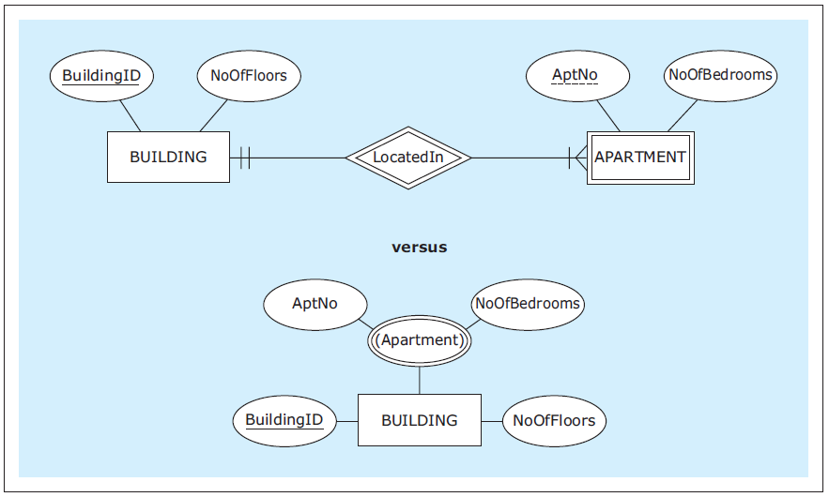
WEAK ENTITY
A weak entity versus a multivalued composite attribute
Jukić, Vrbsky, Nestorov – Database Systems
Chapter 2 – Slide <number>
Notes:
This example is discussed and a comparison between weak entities and multivalued composite attributes is given on Pages 31-32.

Slide 54
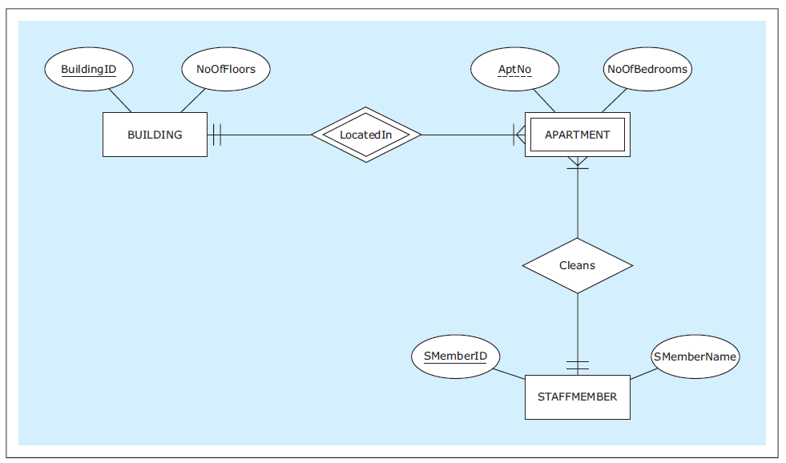
WEAK ENTITY
A weak entity with an identifying and regular relationship
Jukić, Vrbsky, Nestorov – Database Systems
Chapter 2 – Slide <number>
Notes:
This example is discussed on Page 32.

Slide 55
WEAK ENTITY
Identifying relationship is either 1:M or 1:1 relationship
  In case of 1:M identifying relationship, a weak entity must have a partial key attribute
  In case of 1:1 identifying relationship, a weak entity doesn’t need to have a partial key attribute
Jukić, Vrbsky, Nestorov – Database Systems
Chapter 2 – Slide <number>

Slide 56
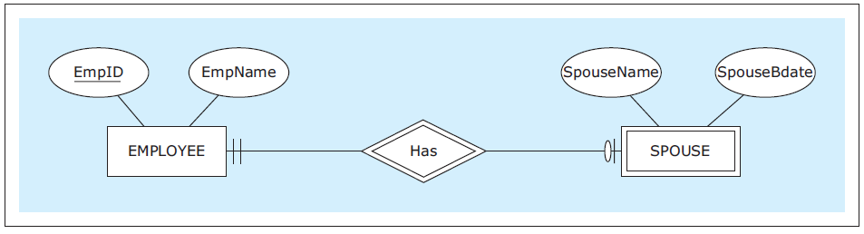
WEAK ENTITY
A weak entity with a 1:1 identifying relationship
Jukić, Vrbsky, Nestorov – Database Systems
Chapter 2 – Slide <number>
Notes:
This example is discussed on Pages 32-33.

Slide 57
NAMING CONVENTIONS FOR ER DIAGRAMS
Entities and attributes
  Use singular (rather than plural) nouns
Relationships
  Use verbs or verb phrases, rather than nouns
Jukić, Vrbsky, Nestorov – Database Systems
Chapter 2 – Slide <number>
Notes:
For example:
- entity names STUDENT, STORE, and PROJECT are better choices than STUDENTS, STORES and PROJECTS
- attribute name Phone is a better choice than the attribute name Phones
- relationship names Inspects, Manages, and BelongsTo are better choices than Inspection, Management and Belonging

Slide 58
NAMING CONVENTIONS FOR ER DIAGRAMS
Names should be as brief as possible, without being too condensed as to obscure the meaning of the construct
If possible, give all attributes in the entire ER diagram different names
Jukić, Vrbsky, Nestorov – Database Systems
Chapter 2 – Slide <number>
Notes:
For example:
- entity name STUDENT is a better choice than UNIVERSITY STUDENT (unnecessarily wordy) or US (too cryptic)
- use EmpName and CustName as names for attributes of entities EMPLOYEE and CUSTOMER respectively, instead of name Name for both attributes

Slide 59
MULTIPLE ER DIAGRAMS
When depicting multiple ER diagrams, each diagram should be visualized separately
Instead of multiple ER diagrams in one schema a better choice is to present each ER diagram separately
Jukić, Vrbsky, Nestorov – Database Systems
Chapter 2 – Slide <number>

Slide 60
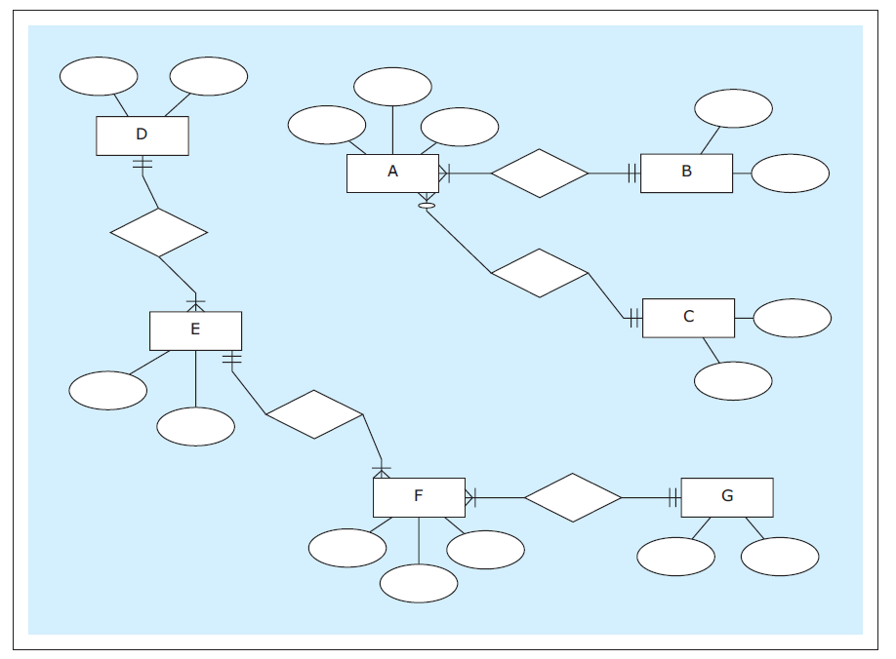
MULTIPLE ER DIAGRAMS
A schema with two separate ER diagrams (potentially misleading)
Jukić, Vrbsky, Nestorov – Database Systems
Chapter 2 – Slide <number>
Notes:
This example is discussed on Pages 33-35.

Slide 61
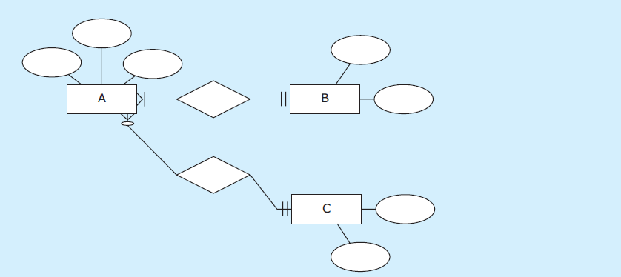
MULTIPLE ER DIAGRAMS
Separate ER diagrams in separate schemas
Jukić, Vrbsky, Nestorov – Database Systems
Chapter 2 – Slide <number>
Notes:
This example is discussed on Pages 33-35.

Slide 62
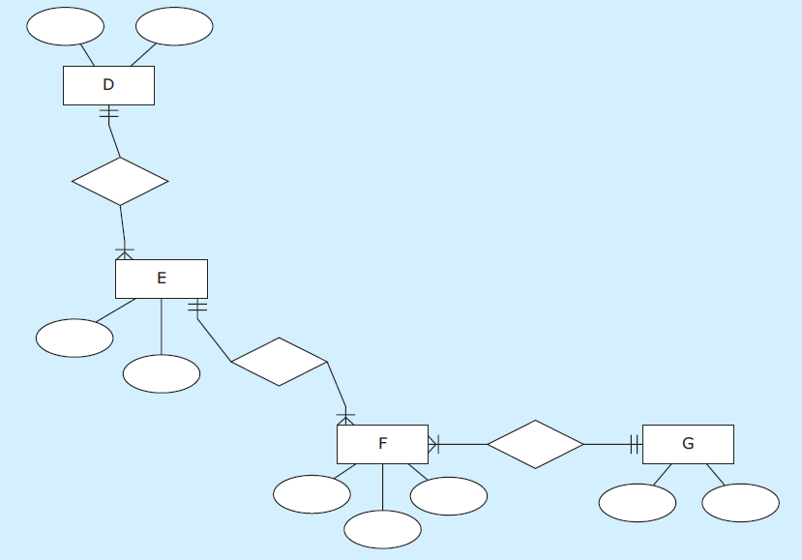
MULTIPLE ER DIAGRAMS
Separate ER diagrams in separate schemas
Jukić, Vrbsky, Nestorov – Database Systems
Chapter 2 – Slide <number>
Notes:
This example is discussed on Pages 33-35.

Slide 63
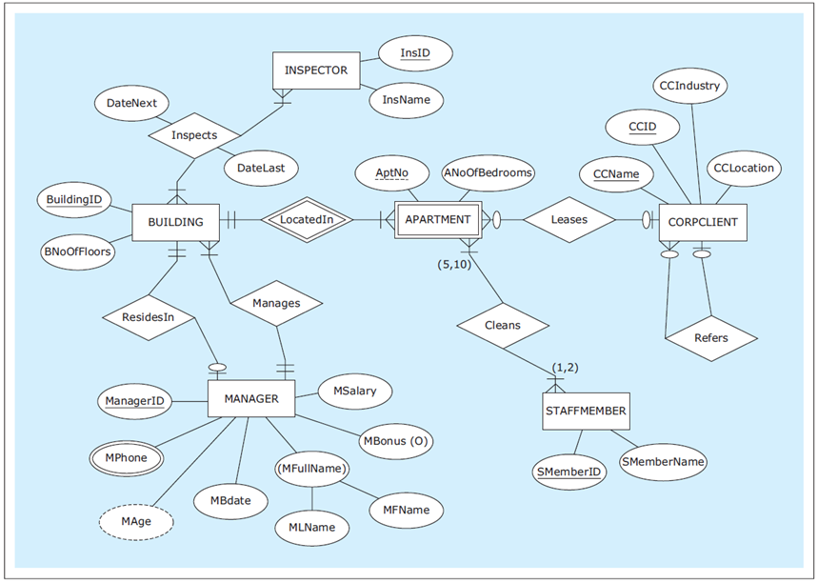
Another ER diagram example: HAFH Realty Company Property Management Database
Jukić, Vrbsky, Nestorov – Database Systems
Chapter 2 – Slide <number>
Notes:
HAFH Realty Company Property Management Database requirements are given on Pages 35-36.

Slide 64
DATABASE REQUIREMENTS AND ER MODEL USAGE
ER modeling provides a straightforward technique for collecting, structuring, and visualizing requirements
An understanding of ER modeling is crucial, not just for creating ER models based on the requirements, but also during the requirements collection process itself
It helps keep the focus on asking or seeking answers to the right questions in order to establish the relevant facts about entities, attributes, and relationships
Jukić, Vrbsky, Nestorov – Database Systems
Chapter 2 – Slide <number>

Slide 65
DATABASE REQUIREMENTS AND ER MODEL USAGE
One of the common mistakes that beginners make when engaging in ER modeling for the first time is not recognizing the difference between an entity and the ER diagram itself
Jukić, Vrbsky, Nestorov – Database Systems
Chapter 2 – Slide <number>

Slide 66
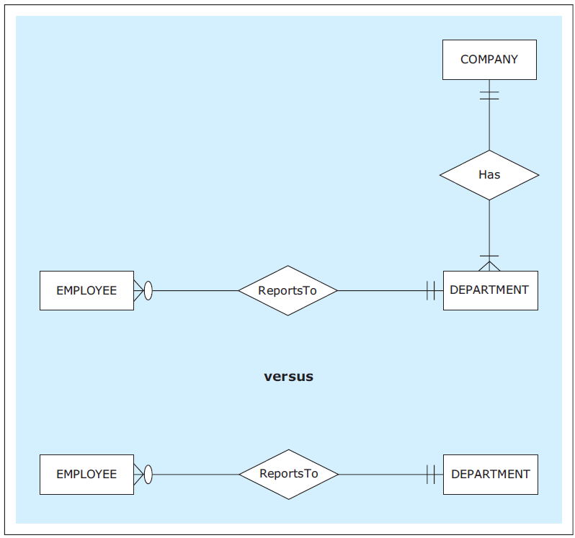
DATABASE REQUIREMENTS AND ER MODEL USAGE
An ER diagram incorrectly and correctly interpreting requirements
Jukić, Vrbsky, Nestorov – Database Systems
Chapter 2 – Slide <number>
Notes:
This example is discussed on Page 36.

Slide 67
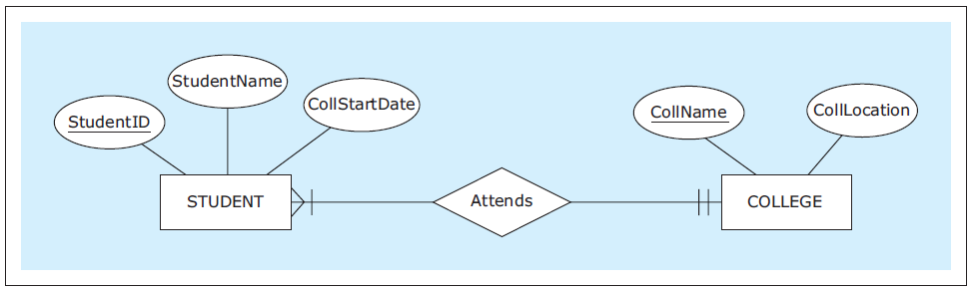
DATABASE REQUIREMENTS AND ER MODEL USAGE
An ER diagram incorrectly and correctly interpreting requirements
Jukić, Vrbsky, Nestorov – Database Systems
Chapter 2 – Slide <number>
Notes:
This example is discussed on Pages 36-37.

Slide 68
DATABASE REQUIREMENTS AND ER MODEL USAGE
Another common database requirements collection and ER modeling mistake made by novices is not distinguishing between:
  Modeling of the data that is wanted and can be kept track of
  versus
  Modeling of everything that takes place in an organization
Jukić, Vrbsky, Nestorov – Database Systems
Chapter 2 – Slide <number>

Slide 69
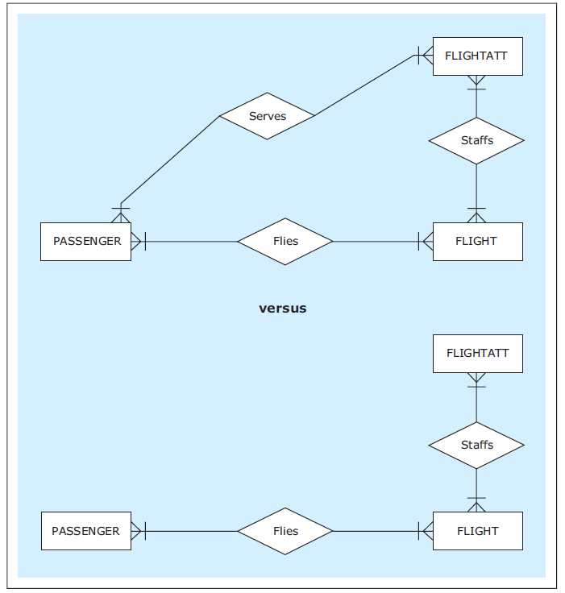
DATABASE REQUIREMENTS AND ER MODEL USAGE
An ER diagram based on unfeasible and proper requirements
Jukić, Vrbsky, Nestorov – Database Systems
Chapter 2 – Slide <number>
Notes:
This example is discussed on Pages 37-38.

Slide 70
VARIOUS ER NOTATIONS
There is no universally adopted ER notation to which all database projects conform
Instead, there is a variety of available ER notations in use
However, if a designer is familiar with one ER notation, other alternative ER notations are easy to understand and use
Jukić, Vrbsky, Nestorov – Database Systems
Chapter 2 – Slide <number>

Slide 71
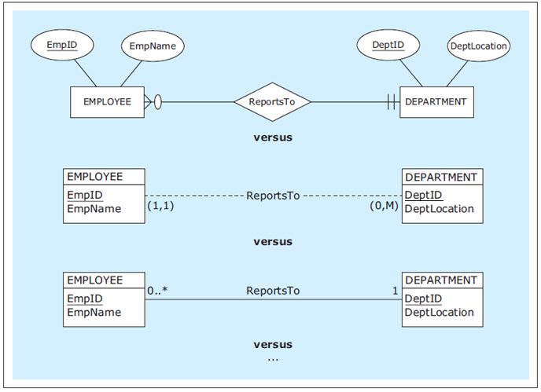
VARIOUS ER NOTATIONS
Examples of various ER notations
Jukić, Vrbsky, Nestorov – Database Systems
Chapter 2 – Slide <number>
Notes:
These notations are discussed on Page 39.

Slide 72
M:N RELATIONSHIPS WITH MULTIPLE INSTANCES BETWEEN THE SAME ENTITIES
In some cases, M:N relationships can have multiple occurrences between the same instances of involved entities
  The following examples illustrates such cases
Jukić, Vrbsky, Nestorov – Database Systems
Chapter 2 – Slide <number>

Slide 73
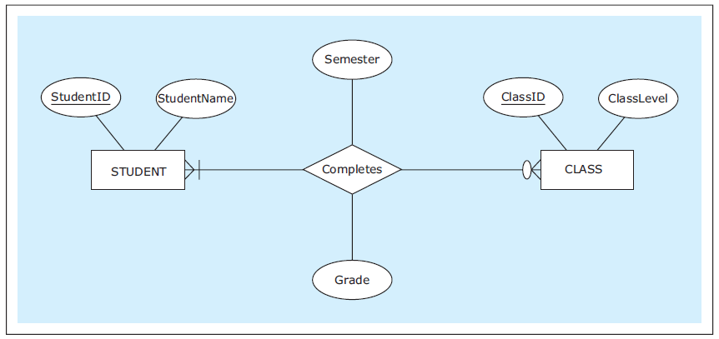
M:N RELATIONSHIPS WITH MULTIPLE INSTANCES BETWEEN THE SAME ENTITIES
An ER diagram for an M:N relationship depicting students completing classes
Jukić, Vrbsky, Nestorov – Database Systems
Chapter 2 – Slide <number>
Notes:
This example is discussed on Pages 40-42.

Slide 74
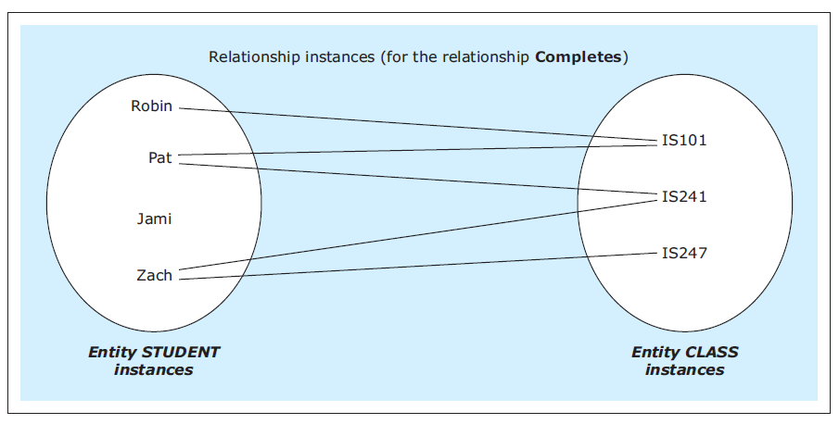
M:N RELATIONSHIPS WITH MULTIPLE INSTANCES BETWEEN THE SAME ENTITIES
Instances of the M:N relationship Completes
Jukić, Vrbsky, Nestorov – Database Systems
Chapter 2 – Slide <number>
Notes:
This example is discussed on Pages 40-42.

Slide 75
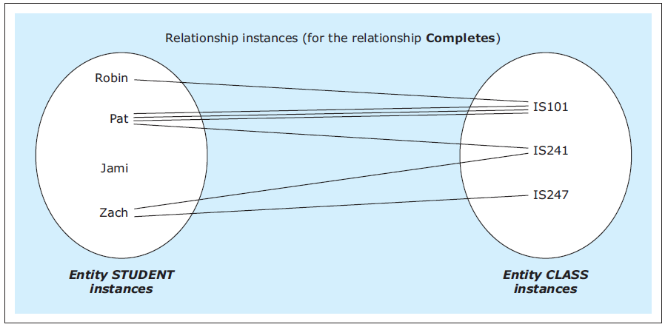
M:N RELATIONSHIPS WITH MULTIPLE INSTANCES BETWEEN THE SAME ENTITIES
Instances of the M:N relationship Completes with an additional requirement
Jukić, Vrbsky, Nestorov – Database Systems
Chapter 2 – Slide <number>
Notes:
This example is discussed on Pages 40-42.

Slide 76
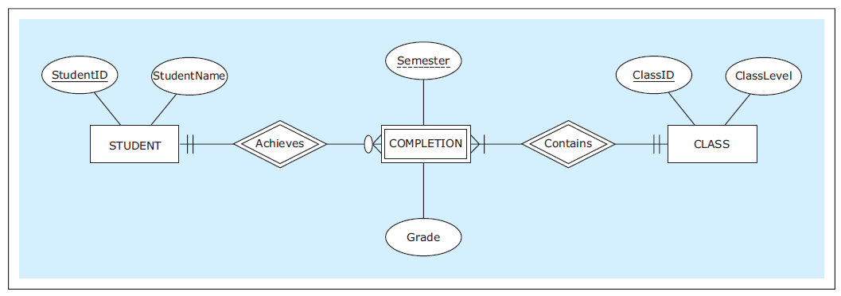
M:N RELATIONSHIPS WITH MULTIPLE INSTANCES BETWEEN THE SAME ENTITIES
An ER diagram for an M:N relationship represented as a weak entity
Jukić, Vrbsky, Nestorov – Database Systems
Chapter 2 – Slide <number>
Notes:
This example is discussed on Pages 40-42.

Slide 77
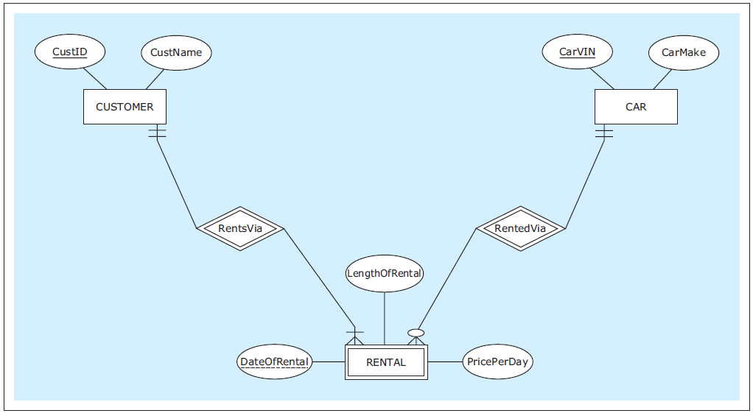
M:N RELATIONSHIPS WITH MULTIPLE INSTANCES BETWEEN THE SAME ENTITIES
Another M:N relationship represented as a weak entity
Jukić, Vrbsky, Nestorov – Database Systems
Chapter 2 – Slide <number>
Notes:
This example is discussed on Pages 42-43.

Slide 78
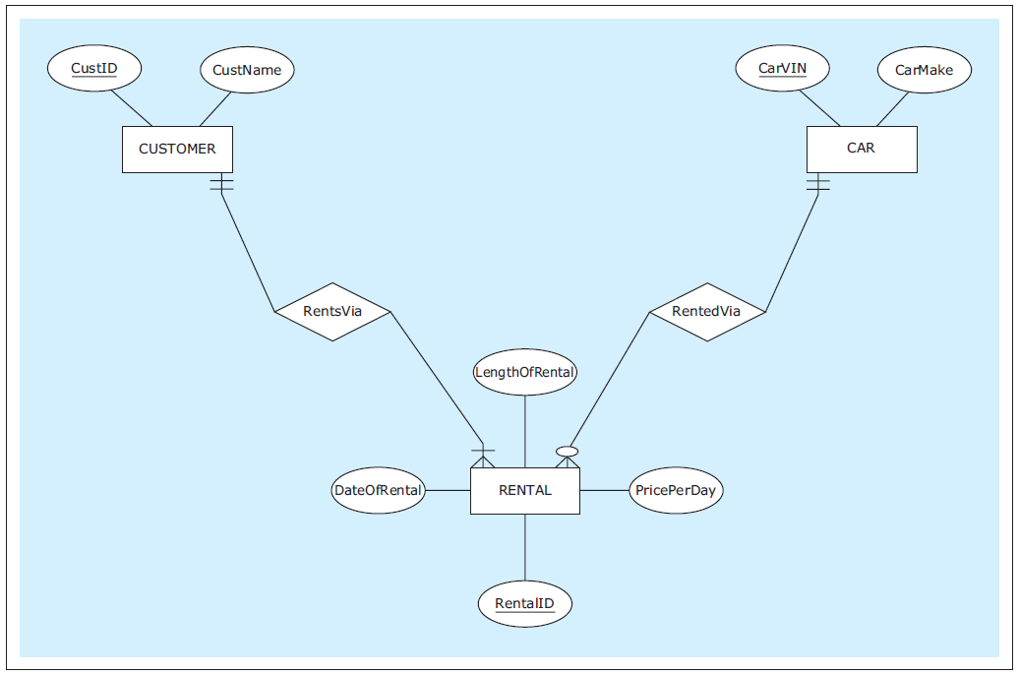
M:N RELATIONSHIPS WITH MULTIPLE INSTANCES BETWEEN THE SAME ENTITIES
A regular entity, instead of an M:N relationship represented as a weak entity
Jukić, Vrbsky, Nestorov – Database Systems
Chapter 2 – Slide <number>
Notes:
This example is discussed on Pages 42-43.

Slide 79
ASSOCIATIVE ENTITY
Associative entity - construct used as an alternative way of depicting M:N relationships
  Associative entities do not have unique or partially unique attributes, and often do not have any attributes at all
Jukić, Vrbsky, Nestorov – Database Systems
Chapter 2 – Slide <number>

Slide 80
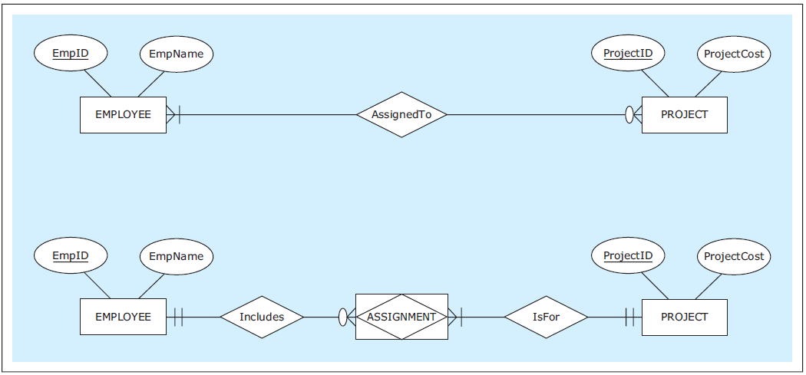
ASSOCIATIVE ENTITY
An identical relationship represented as a M:N relationship and as an associative entity
Jukić, Vrbsky, Nestorov – Database Systems
Chapter 2 – Slide <number>
Notes:
This example is discussed on Pages 43-44.

Slide 81

ASSOCIATIVE ENTITY
An identical relationship represented as a unary M:N relationship and as an associative entity
Jukić, Vrbsky, Nestorov – Database Systems
Chapter 2 – Slide <number>
Notes:
This example is discussed on Page 44.

Slide 82

ASSOCIATIVE ENTITY
An identical relationship represented as an M:N relationship with an attribute and as an associative entity with an attribute
Jukić, Vrbsky, Nestorov – Database Systems
Chapter 2 – Slide <number>
Notes:
This example is discussed on Page 44.

Slide 83
ASSOCIATIVE ENTITY
For relationships with a degree higher than 2 such as ternary relationships, associative entities provide a way to eliminate potential ambiguities in the ER diagrams
Jukić, Vrbsky, Nestorov – Database Systems
Chapter 2 – Slide <number>
Notes:
Associative entities are not necessary constructs for depicting binary or unary relationships (for binary or unary relationships, associative entities are simply another way of depicting a relationship).

Slide 84
TERNARY RELATIONSHIP
Ternary relationship - relationship involving three entities (degree 3 relationship)
Jukić, Vrbsky, Nestorov – Database Systems
Chapter 2 – Slide <number>

Slide 85

TERNARY RELATIONSHIP
Three binary relationships that are insufficient for depicting given requirements
Jukić, Vrbsky, Nestorov – Database Systems
Chapter 2 – Slide <number>
Notes:
This example is discussed on Pages 45-46.

Slide 86

TERNARY RELATIONSHIP
A ternary relationship
Jukić, Vrbsky, Nestorov – Database Systems
Chapter 2 – Slide <number>
Notes:
This example is discussed on Page 46.

Slide 87

TERNARY RELATIONSHIP
A ternary relationship via associative entity
Jukić, Vrbsky, Nestorov – Database Systems
Chapter 2 – Slide <number>
Notes:
This example is discussed on Pages 46-48.

Slide 88

TERNARY RELATIONSHIP
A regular entity replacing a ternary relationship
Jukić, Vrbsky, Nestorov – Database Systems
Chapter 2 – Slide <number>
Notes:
This example is discussed on Page 48.

Slide 89

TERNARY RELATIONSHIP
A many-to-many-to-one ternary relationship
Jukić, Vrbsky, Nestorov – Database Systems
Chapter 2 – Slide <number>
Notes:
This example is discussed on Page 48.

Slide 90

TERNARY RELATIONSHIP
A many-to-many-to-one ternary relationship
Jukić, Vrbsky, Nestorov – Database Systems
Chapter 2 – Slide <number>
Notes:
This example is discussed on Page 48.

Slide 91
TERNARY (AND HIGHER DEGREE) RELATIONSHIPS
In practice, ternary relationships are relatively rare, and relationships of degree higher than 3 are rarer still
Jukić, Vrbsky, Nestorov – Database Systems
Chapter 2 – Slide <number>
Notes:
In most cases when a designer is tempted to create relationships of degrees higher than 2, he or she should explore the possibility of creating additional entities instead.

